Slide 1
Footprints:
Best Practice with neonatal hoglets
Copyright: Hedgepigs 2023

Slide 2
What we know
Mating
Gestation
Healthy female
Unhealthy / older female
Sickness
Hibernation
Disturbing nests
Fillial Cannibalism
Abandonment
Copyright: Hedgepigs 2023

Slide 3
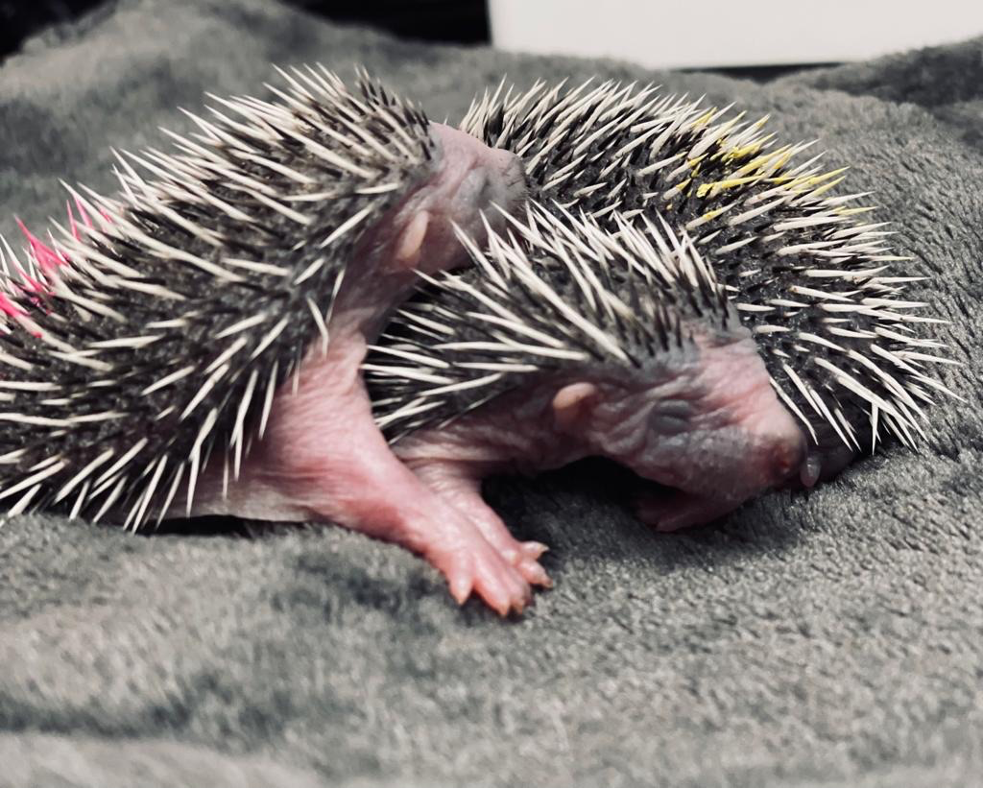
Advice to finders of neonatal hoglets
Observe from afar
You’ve come across them close up – step away (at least a few metres)
Keep quiet
Prevent mum smelling and hearing you – depending on wind direction
Keep children and animals away
Observe for mum for 1 – 2 hours max
Mum returns
Water and food available (wet preferrable because it helps with hydration)
In summer dry food in the day – not too close to nest to stop predators getting too close
If you see mum out in the day – moving with purpose – don’t worry
Copyright: Hedgepigs 2023

Slide 4
What if mum doesn't return?
Ask the finder not to handle the hoglets with bare hands.
Pick them up in soft tissue handkerchiefs or pieces of clean, soft cotton and to place them in a small box lined with very soft material with no holes or sharp edges.
Facial tissues or soft cotton material are fine, hay, straw, sawdust or cut grass is not warm enough.
Ask them to place something in the box to keep the hoglets warm.
A small screw capped plastic drinks bottle filled with hot water, makes a good temporary heater when wrapped in soft material so the hoglets do not burn themselves.
It is also important to keep the box away from noise.
Copyright: Hedgepigs 2023

Slide 5
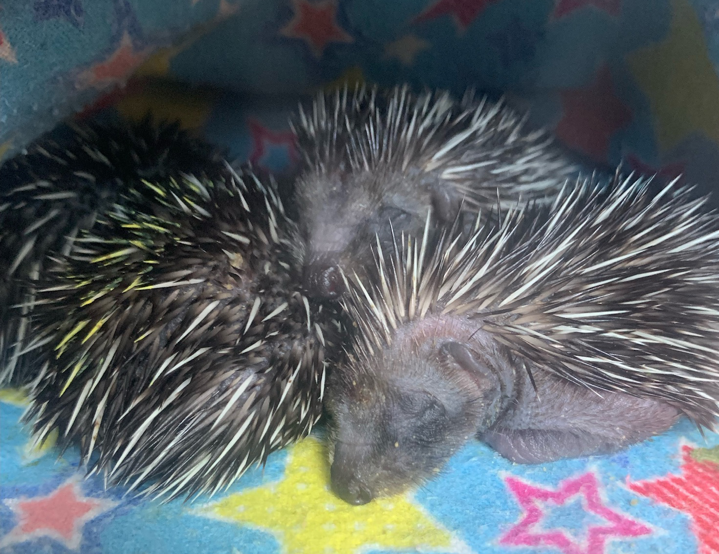
Day 1: In the rescue
Incubator set to 32 if large, if it’s a carrier incubator set to 30 (Heat rises so the bottom of the incubator will be a degree or 2 lower than the temperature set).
They should be warmed up as quickly as possible
Fluids only – a 20gm hoglet will require 1ml fluid daily, adjust according to weight
Synluox, sub cut 0.7 per kg
Copyright: Hedgepigs 2023

Slide 6
Day 2: until eyes open
Formula: Body weight / 4 – this is the amount of formula to give across 6 feeds.
Include recovery oil in feeds (scraped off the top of the recovery pate)
Then include a some recovery pate in feeds
Feeds should be from 6 am to 10 pm
First feed should be half strength
Only toilet after the first feed in the morning and last feed at night – use almond oil as a lubricant and follow with a nappy cream (Bepanthen)
Continue fluids
Continue Synulox
Copyright: Hedgepigs 2023

Slide 7
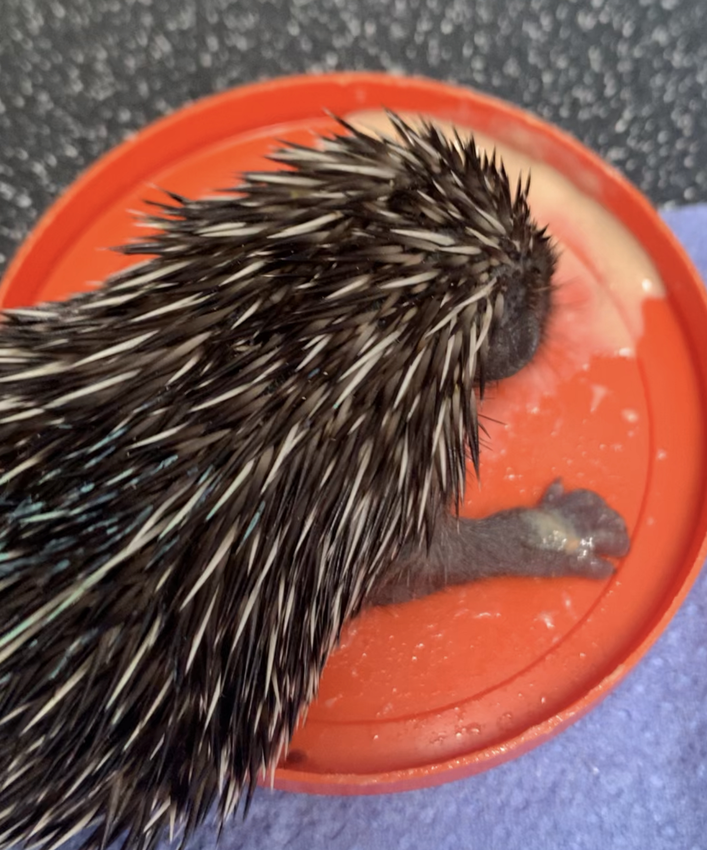
Once Eyes are open
Wean straight away, move to starter mousse mixed with water, not formula
Stop synulox
Stop Fluids
Reduce incubator heat by 2 degrees
At 200 gms move to cage with heat pad
If at this point they go off food, dose with Dex/Diatrim/Tribrissen for 10 days
Copyright: Hedgepigs 2023

Slide 8
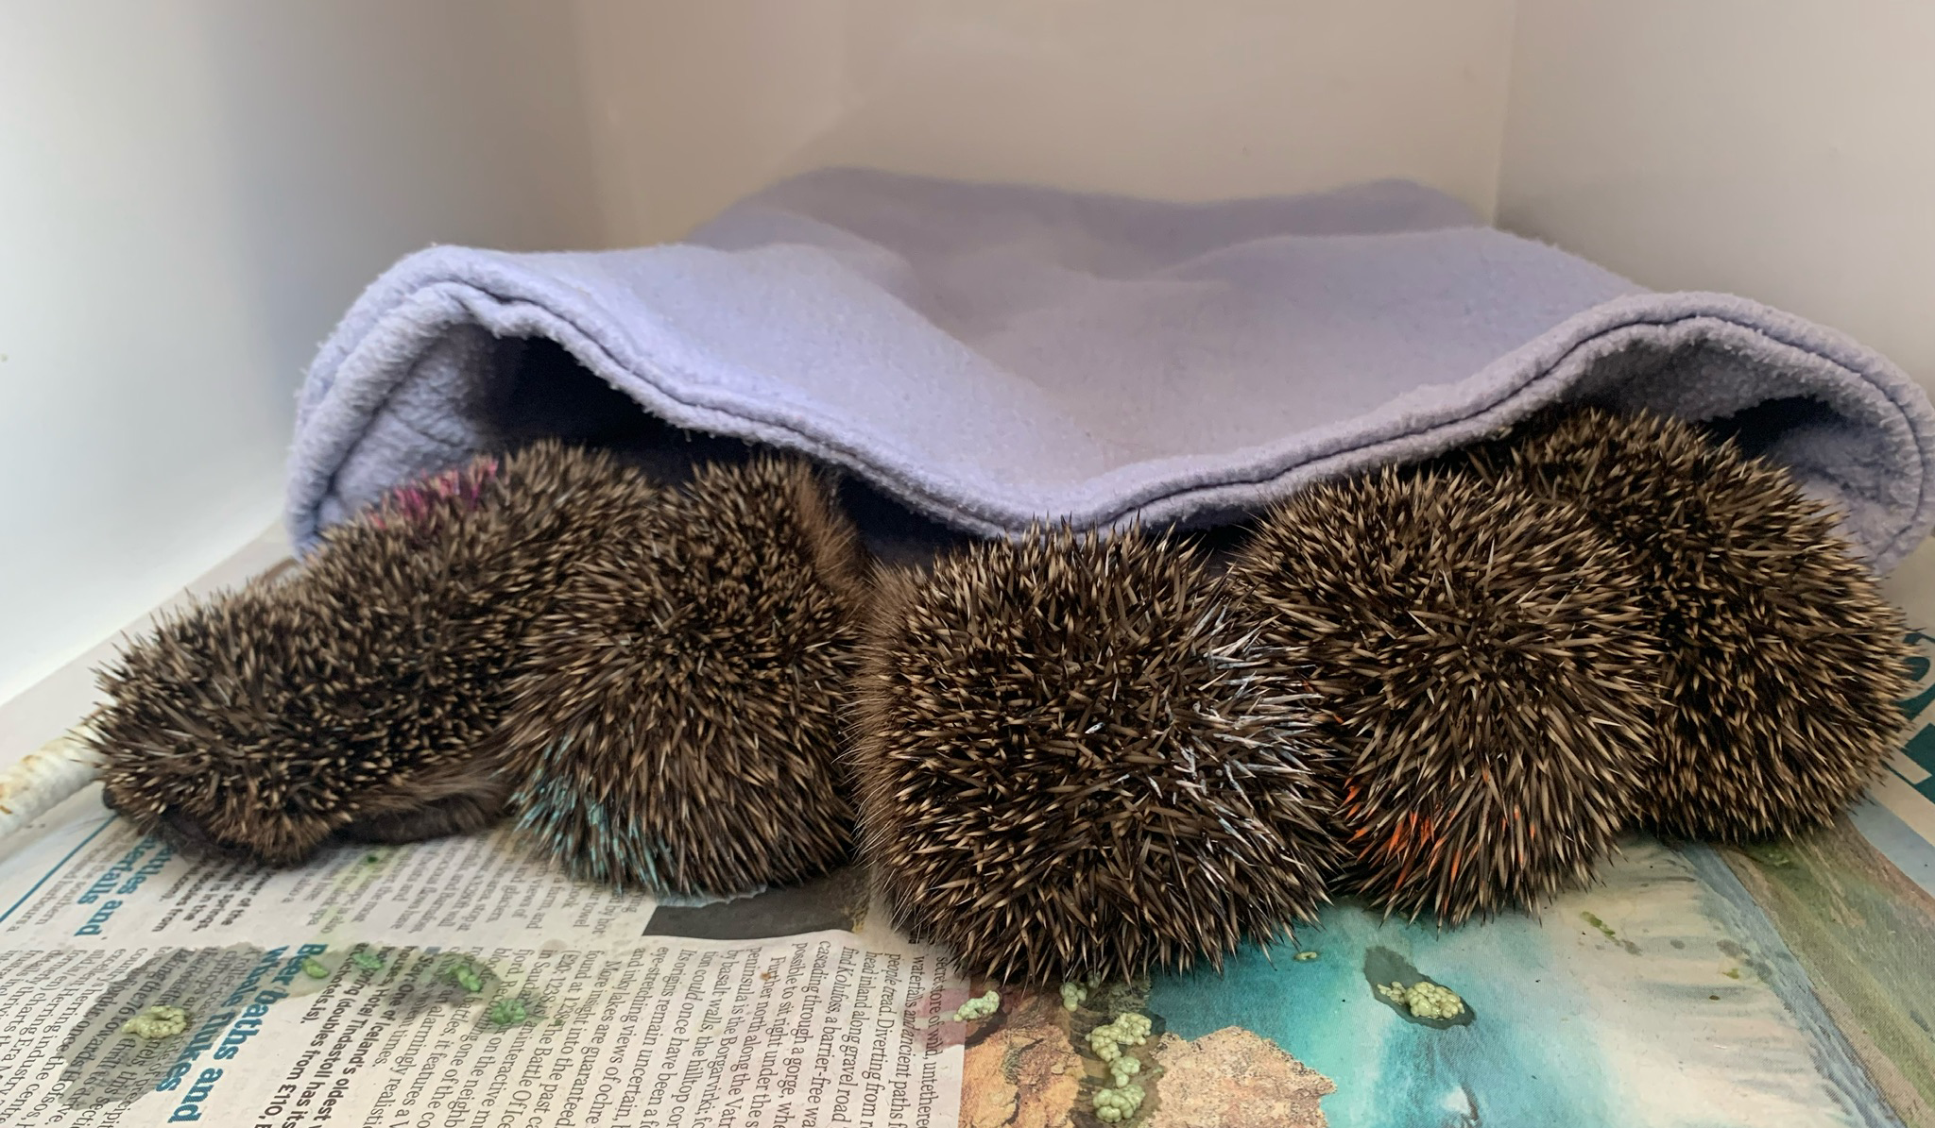
Other considerations
Identification if more than one in litter
Record keeping
Bloat
Urine / fecal burn
Copyright: Hedgepigs 2023

Slide 9
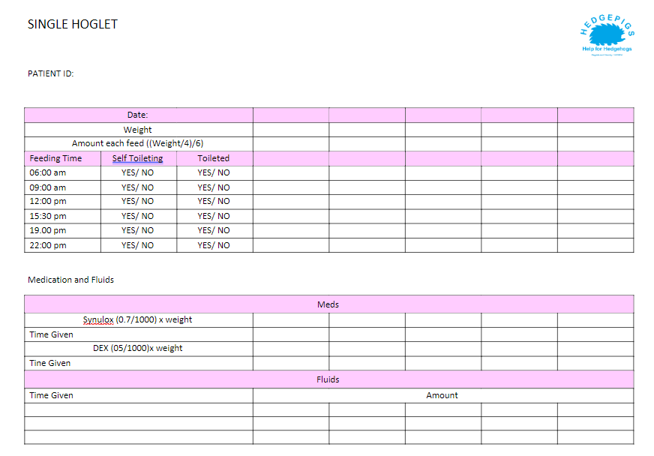
Copyright: Hedgepigs 2023

Slide 10
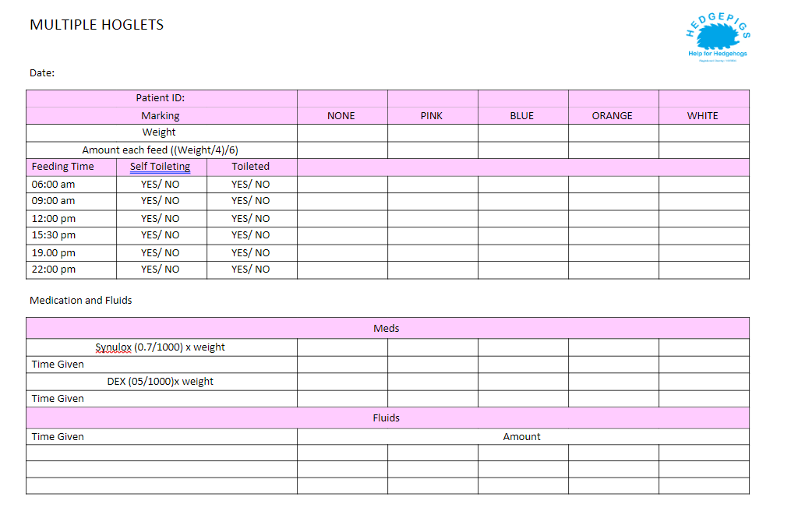
Copyright: Hedgepigs 2023

Slide 11
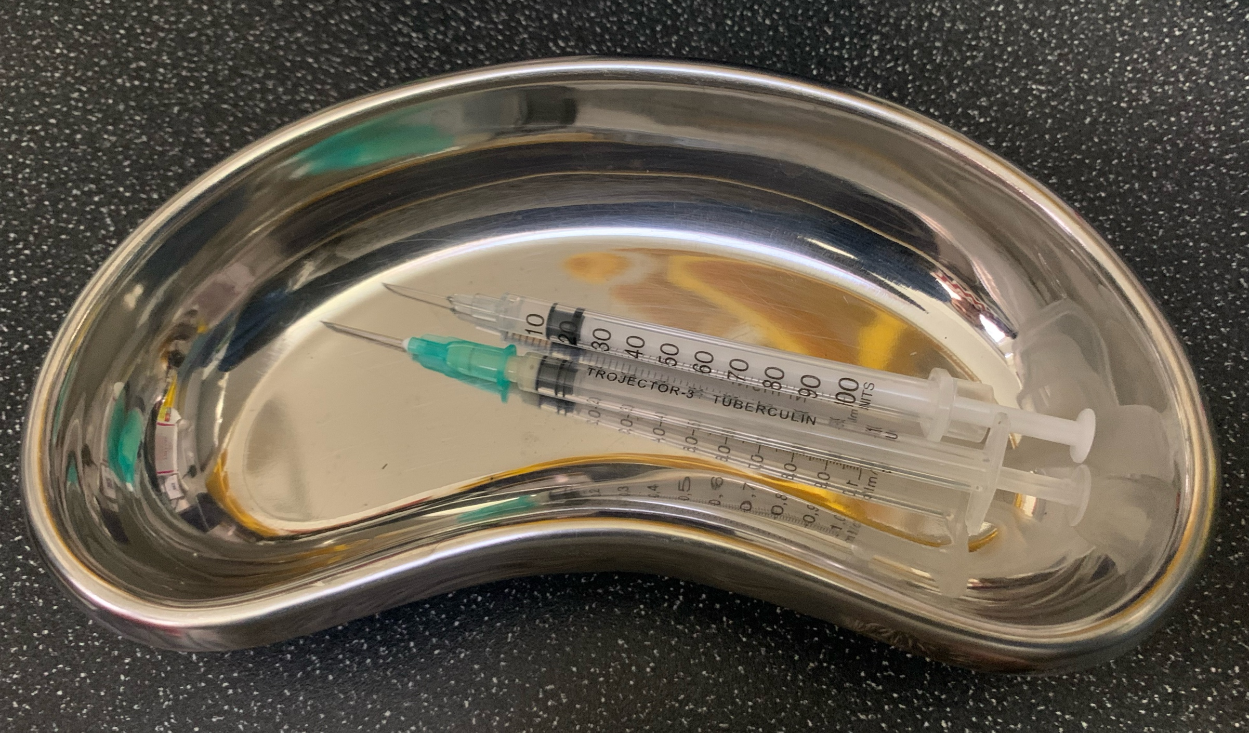
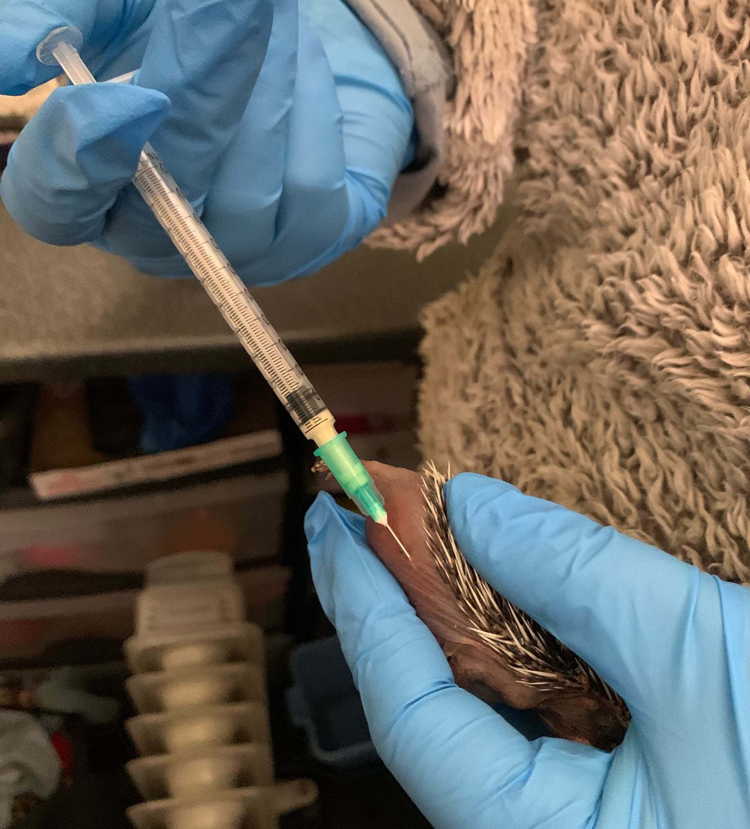
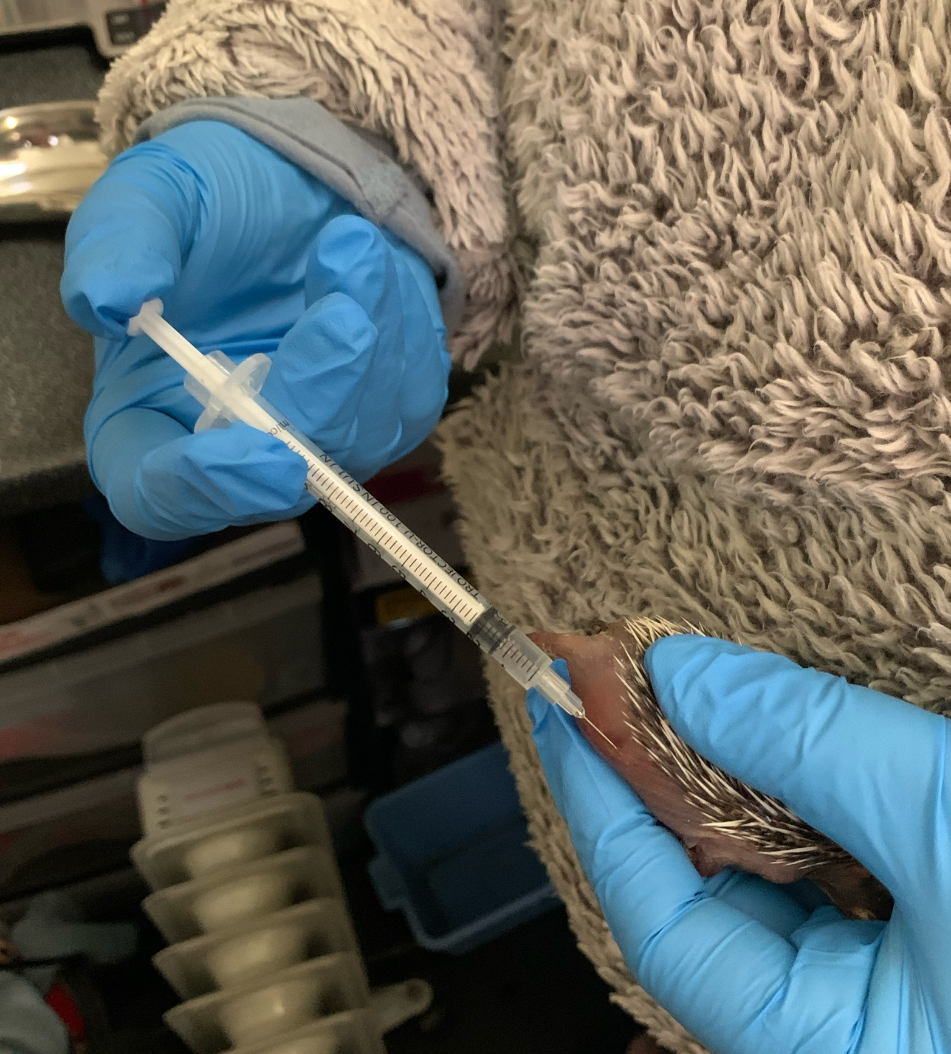
Handling & Injection Technique
Copyright: Hedgepigs 2023
Notes:
Have all of your made up syringes in a sterile dish ready to inject, so that you aren’t messing around in between injections and stressing the hoglet
Remember the saying, can you pinch more than an inch?
Pinch the side of hoglet to get a nice roll of flesh to inject into, going at an angle and flat to the hoglet so as to avoid organs and too many nerves
This was a dead hoglet used to take pictures. So it was hard to really demonstrate on

Slide 12
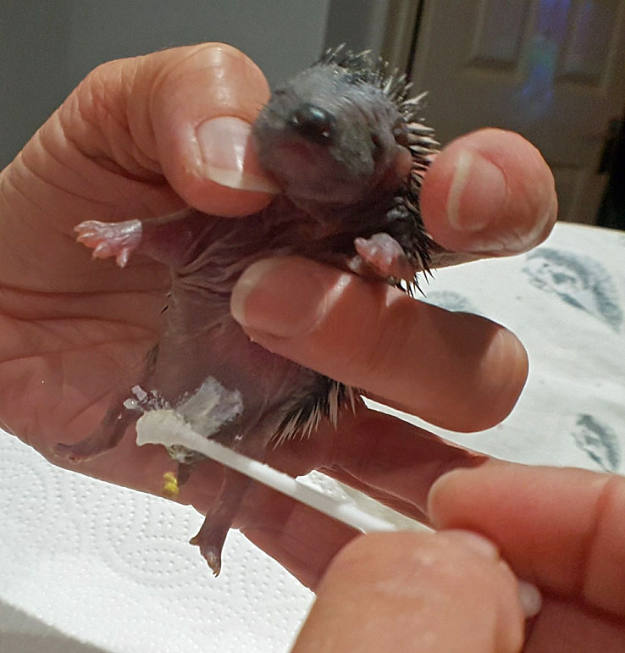
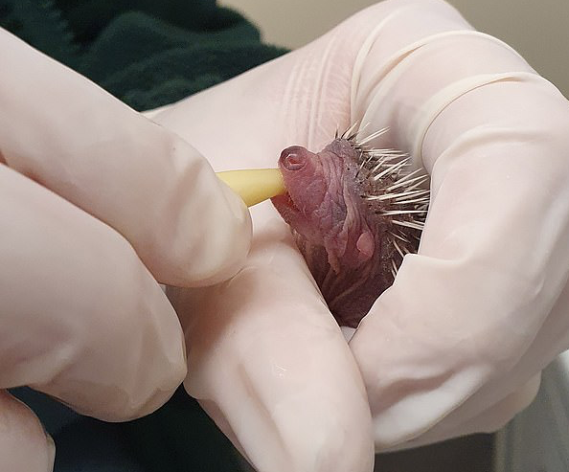
Handling & Toileting
Copyright: Hedgepigs 2023
Notes:
Please note, these are not our images.
You should always wear gloves or hold hoglet in a tissue to avoid getting oil from your hands onto their skin.

